Slide 1
Ultimate design low noise microcomb amplifier
Questions
Why is ASE canceled or minimized in the middle?
Why loss at the beginning of the fiber degrades the noise figure?
Problem with Isolator and high pump?
Why the inversion needs to be max at the input of the fiber for reducing the noise?
Why forward pumping gives lower efficiency? Why backward pumping has higher efficiency?
Why longer length gives higher ASE?
Why noise is lower in forward pumping?
Why not operate with lower active gain fiber like 5 dB?
Saturation regime for second amplifier?
Why do we want low noise figure in the first amplifier?
Why do we work (in the small signal gain not) in the saturation regime
Why higher inversion gives lower noise figure?
Why high gain in short fiber reduces ASE → because saturation regime? but high gain for long fiber increases ASE? → outside saturation regime? No, higher power needed to keep the inversion high, higher gain which increases the ASE power as well.
Why do we want a short fiber?
Why SNR increases with input power?
Saturation regime.
Gain vs. pump power for different length fibers.
Small signal gain. What is it?

Slide 2





First, some definitions…
5.4

Slide 3




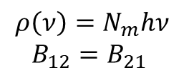
Where does this equation come from?
About
Photon density in the mode $N_{m}$:
Stim.
Abs.
ASE
$$ρ\left(ν\right)=N_{m}hν$$
$$B_{12}=B_{21}$$
x 2
.
if single mode fiber with two polarization modes
For getting the power, we compute the number of modes in the frequency band $Δν$ around the frequency $hν$

Slide 4

Noise figure
$NF=\frac{SNR_{i}}{SNR_{o}}$ $SNR_{i}= \frac{I_{s}^{2}}{shot noise}$
$SNR_{o} \sim \frac{{\left(G I \right)}^{2}}{Shot noise+(signal−ASE) noise}$ $SNR_{i}= \frac{I_{s}^{2}}{shot noise}$
$NF=2 n_{sp}\frac{(G−1)}{G}+\frac{1}{G}+…$
Why do we want low noise at the beginning of the amplifier?
$SNR_{i}=\frac{S_{i}}{N_{i}}$
$SNR_{o}=\frac{S_{i}G_{1}G_{2}G_{3}}{N_{i}G_{1}G_{2}G_{3}+N_{A1}G_{2}G_{3}+N_{A2}G_{3 }+N_{A3}}$
$SNR_{o}=NF_{1}+ \frac{NF_{2}−1}{G_{1}}+\frac{NF_{3}−1}{G_{1}G_{2}}$
Noise figure is determined primarly by the conditions at the input to the fiber where the inversion is in turn determined by the Backward ASE. Increasing the length of a short fiber increases the backwards ASE significantly, reducing the inversion level → Noise figure increases.
The first amplifier has the most significant effect given the noise figures of the following stages are reduced by stage gains.
The first amplifier should have a low noise figure, and the noise figure requirements of subsequent stages can be more relaxed.

Slide 5
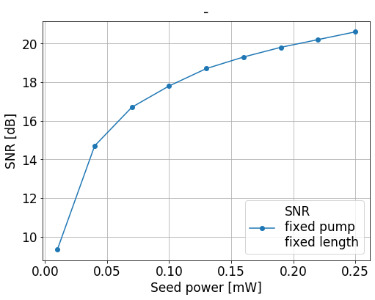
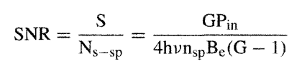
Why SNR increases with input power?
More power is taken by the input signal and does not leave so much inversion available for ASE generation
Notes:
The small signal gain and the saturation output power both increase with pump power.

Slide 6
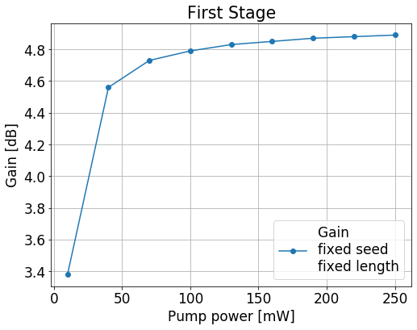
Saturation regime.
As the signal increases in power beyond the small signal value, the gain decreases since the pump cannot longer replenish the inversion as fast as the signal depletes it.
Operation at small signal gain instead or saturation regime?
Operation in the saturation regime. Independent from pump power noise. High inversion. Low noise.
Why saturation regime brings down ASE?
There is an interplace. If you are in this regime, more seed will not have a higher amplification but this also means there is a very few amount of residual inversion that ASE can catch up.
If the seed is very weak, then ASE can collect a large amount of the inversion and therefore be amplified.
Notes:
ASE starts with low power so it will not to go so high power levels. Your seed is rather high power level and it is already at the saturation. The seed collects most of the inversion such as there is nothing really left for the ASE to be built up in an efficient way. Because it is more powerful

Slide 7
Why not operate with 5 dB/m gain fiber?
Case 1:
We want to get a gain of 5 dB → We need therefore more than 3 m of fiber (with 22 dB ~ 0.5 m)
Higher pump powers are also now required at the input to invert the entire fiber, especially toward the end of the fiber.
Such amount of high power plus longer fiber generates a larger amount of ASE
Considering an inversion that remains constant throughout all fiber, the ASE increases exponentially with length.
With increasing ﬁber length, the values of generated noise will be increased due to the accumulation of previous noise
Case 2:
Short fiber (0.5 m) of 5 dB/m gain. The output gain is less than 1 dB. Forcing the second amplifier to provide the entire needed gain.
Why not operate with 80 dB/m gain fiber?
Too much erbium can be too much of a good thing because of clustering and cooperative up-conversion quenching of the excited state. Clusters: two ions close together that only absorb and no emission → If one ion absorbs, it is excited, if the second is also excited they exchange energy and one of the ions is excited to a higher stage and the other one falls.
Notes:
The inversion is actually lower at the beginnning of the fiber even though the 980 nm pump power is highest there, because the backward propagating ASE has reached ist highest power there and is significantly depleting the inversion.
Plus, backward ASE reduces takes inversion from the signal reducing the gain.

Slide 8
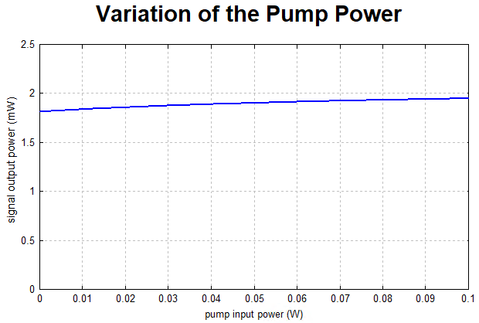
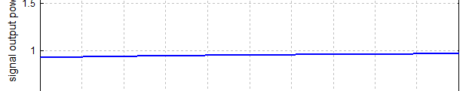
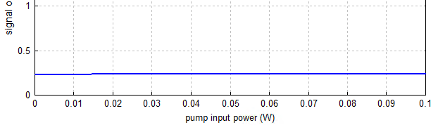
Length and gain.
Low noise figures tipically require shorter lengths of fiber (to reduce the ASE) and high pump power, to achieve the same gain and maximize the inversion.
Why do we want a short fiber?
A shorter fiber the fiber to be well inverted across ist entire length, thus offering a good noise figure.
It keeps the backward ASE to the minimum
However, a significant amount of pump light exits the fiber.
L = 2.5 m
L = 1.5 m
L = 0.5 m
Higher pump power needed to get fully inversion
Higher gain
Higher ASE
Why high gain in short fiber reduces ASE → because saturation regime?
but high gain for long fiber increases ASE? → outside saturation regime? No, higher power needed to keep
the inversion high and therefore, higher gain which increases the ASE power as well.

Slide 9
Copropagating and counterpropagating pumping
Counterpropagating pump is more efficient because the pump is strongest in the region where the signal is strongest.
Thus the signal can most efficiently deplete the inversion, as opposed to allowing the ASE to deplete the inversion
In the copropagating case, the backward ASE has benefited from the high pump powers at the input of the fiber, depleting the inversion and resulting in a backward ASE output that is higher than the signal output
Lowest noise in copropagating pump configuration
In this configuration, the portion of the fiber that the signal enteres tends to be more inverted than the section by which the signal exits. Thus, the signal undergoes more gain per unit length at the beginning of the fiber than at the exit.
In the counterpropagating configuration, the inverse situation is present and the lower gain per unit length at the beginning of the fiber is equivalent to having some amount of loss for the signal before it enters the amplifier.
Any loss that the signal experiences at the beginning of the fiber will degrade the noise figure.
For the optimization of the signal-to-noise ratio, the essential point is to keep the excitation density near the signal input as high as possible. That is actually achieved with forward (copropagating) pumping, where at the signal input we obtain a high pump power.
This argument is not as valid if the fiber is short enough; in that case, assuming that pump power is not limited, a strong enough pump will strongly invert the entire fiber and it will not matter whether the pump is copropagating or counterpropagating.
Notes:
To summarize, the most advantageous situation is to have the signal strong where the inversion is strong, so that the signal, not the ASE, will deplete the gain. The pump configuration that yields the highest conversion efficiency is bidirectional pumping. The resulting flattening of the upper-state population distribution results in an optimum situation with respect to the competition between signal and ASE. Bidirectional pumping yields a few dB more in gain (as compared to the counterpropagating pump) for moderate input powers in the —20 dBm range
As far as small signal gain is concerned, copropagating and counterpropagating pumps yeild the same gain and only the total amount of power matters. This is because the ASE patterns generated by the two pump patterns are mirror images of each other and so the average upper state population is the same in both cases.

Slide 10
With all this in mind…
Multistage amplifier
ASE to be eliminated at the middle point along the fiber amplifier.
It is difficult to obtain simultaneously large gains and very low noise figures in a single stage amplifier.
By reducing the ASE, more gain is available for the signal and less noise is added to it from the spontaneous emission
The first stage needs to be well inverted so that a moderate amout of gain is obtained with minimal noise added.

Slide 11
1st amplifier
Fiber length = Short fiber. To be optimized
Pumping power = Saturation regime
Direction = Given the short fiber, irrelevant
Gain of active fiber = 22 dB/m
Gain ~ 5dB
2nd amplifier
Fiber = Longer fiber for higher gain. To be optimized
Pumping power = Outside small signal gain
Direction = Backward for higher efficiency and relaxed noise requirements
Gain of active fiber = 27 dB/m for higher gain
Gain > 15 dB

Slide 12
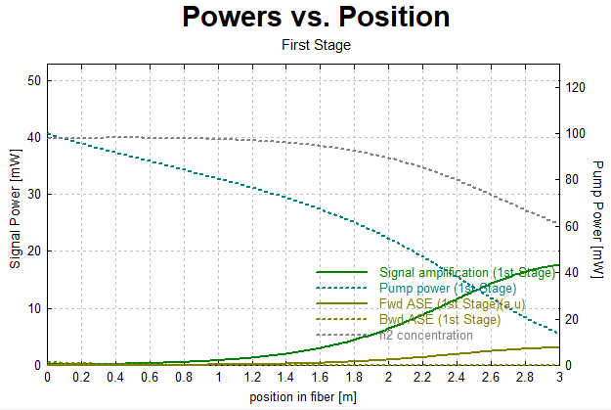
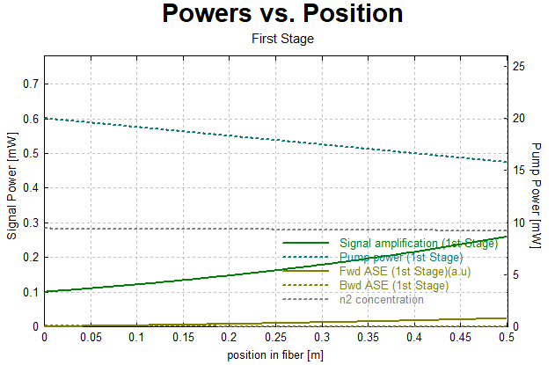
1st amplifier

Slide 13
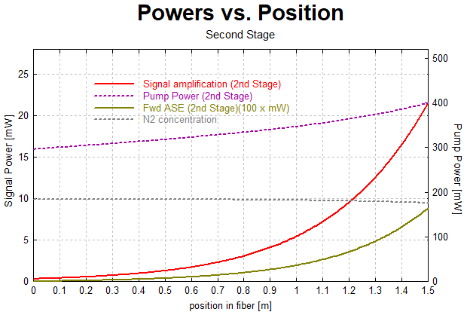
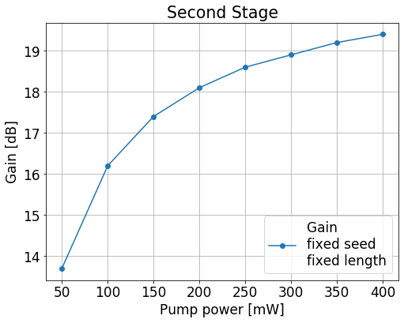
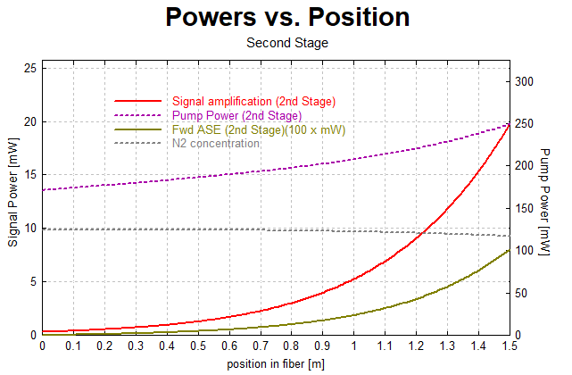
2nd amplifier

Slide 14
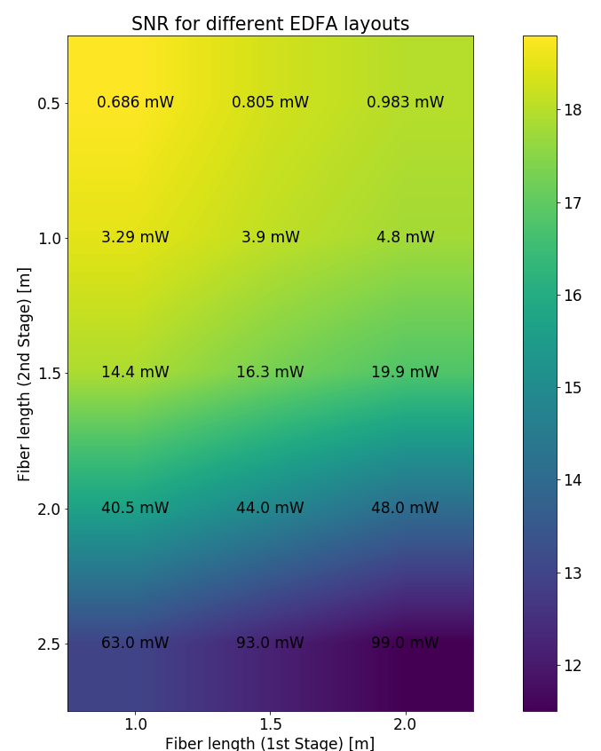
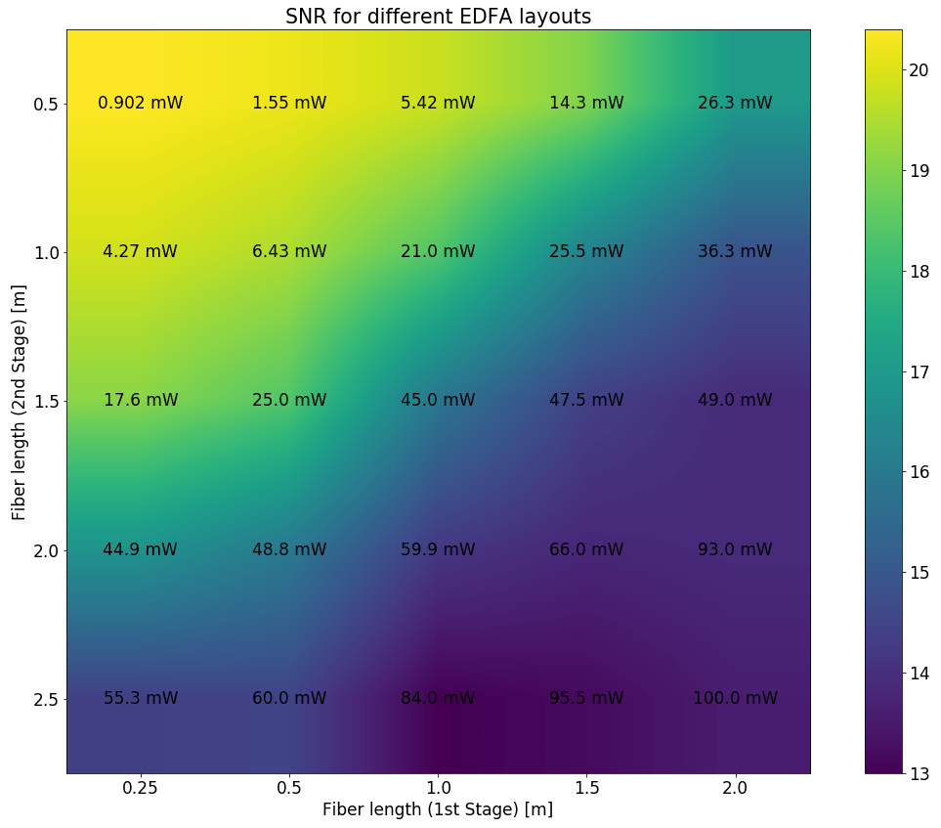
Microcomb weekly meeting – KW 11
Optimization fiber amplifier stages
5 dB – 24 dB
24 dB – 27 dB
1.75 m:
SNR = 18.2 dB
30 mW

Slide 15
Final design
Things to improve the design in case needed:

Slide 16
Ultimate design low noise microcomb amplifier
The peak in the population inversion for 50 mW of pump at 980 nm, near 6m to 8 m, is due to the fact that at this position the total ASE (Backward and forward) is the lowest. The inversion is actually lower at the beginnning of the fiber even though the 980 nm pump power is highest there, because the backward propagating ASE has reached ist highest power there and is significantly depleting the inversion.
From the point of view of the Backward ASE, the 14 m of fiber acts as a source of spontaneous emission followed by a highly inverted piece of fiber. The forward ASE travels over a moderately inverted length of fiber and thus builds up more slowly than the backward ASE.
At higher pump powers, the pump drops very rapidly due to the depletion of the pump by the backward ASE, before settiling to a plateau in the center of the fiber where the ASE is lowest. At the output end, where the the forward ASE is strong the pump is again depleted.
About long fibers:
Higher pump powers are now required at the input to invert the entire fiber, espcially toward the end of the fiber. Such amount of high power generates a large amount of ASE (mostly backward) which reduces the pump efficiency in producing signal gain and results in highers thresholds.

Slide 17
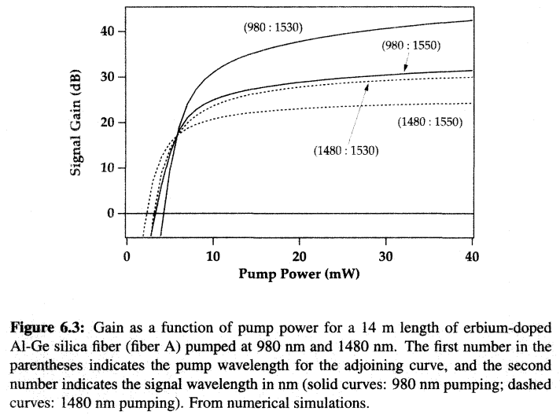
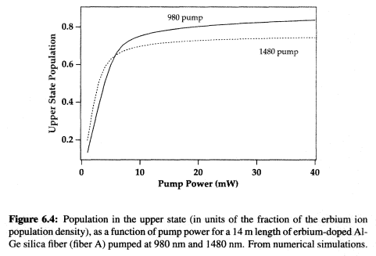
Ultimate design low noise microcomb amplifier
Why?

Slide 18
Truths and lies
From the figure, it is seen that EDFA gain decreases with increasing signal input power. The reason of this is the easier saturation of the EDFA at higher signal powers for a constant pump power.
the gain of the EDFA sharply increases with increasing pump power; after a certain level of gain, the increase in gain becomes smaller when the population inversion is provided for all the erbium ions in the fiber and therefore amplifier goes to saturation. In addition, a higher gain can be obtained if a longer erbium doped fiber is used with sufficient pumping
The fiber background loss, which is less effective in a short distance, causes much higher pump power depletion in a longer fiber. Due to excessive pump depletion in longer distances, the gain obtained from an amplifier begins to decrease after a maximum level.
the gain increases up to a certain length of fiber, and then begins to decrease after a maximum point. The reason for the decrease in gain is insufficient population inversion due to excessive pump depletion and getting higher losses than the provided gain at the signal wavelength due to high total loss of Erbium doped fiber (fiber background loss+Er absorption loss).
The noise ﬁgure for the ampliﬁer is determined by the gain of the ﬁber and the emission to absorption cross-section ratios at the pump and signal wavelengths
with increasing ﬁber length, the values of generated noise will be increased due to the accumulation of previous noise
The more guided modes a fiber has, the more fluorescence light can be captured, and the stronger will be ASE.
The minimum possible amount of ASE is obtained for a single-mode fiber.
In Erbium (quasi-three-level behaviour) signal reabsorption is high, therefore a higher excitation density for a given amount of gain is needed in order to overcome it, and that causes stronger spontaneous emission. That effect is particularly pronounced for ASE in a direction where the excitation density at the beginning of the fiber is low. Therefore, ASE is often stronger in a direction opposite to that of the pump.
In case of a quasi-three-level amplifier, it is important to design it such that it operates with a high excitation level of the laser-active ions near the input end.
Backward pumping is significantly worse in terms of noise, since in that configuration we have a low degree of erbium excitation near the signal input end
In Erbium, we have some signal reabsorption, which increases the excess noise: the absorption itself introduces quantum noise, and the required additional stimulated emission causes more spontaneous emission, which further adds to the noise. That effect becomes more severe for low excitation levels of the laser-active ions, because then the reabsorption is more relevant. Also, it matters mostly whether that effect occurs near the input end of an amplifier, but not much for the output end (if the gain is high), as the excess noise is already strong near the output.
The higher the pump power, the lower the noise figure
The high gain in an active fiber with the total population inversion provided causes the spontaneous emission to stay in low levels. The noise figure of the EDFA varies linearly with ASE power and inversely with the amplifier gain. Therefore, the noise figure of an EDFA can be reduced to a minimum level by increasing the gain

